Slide 1


ADIDAS SALES ANALYSIS
POWER BI

Slide 2

OVERVIEW
This Power BI dashboard provides an analysis of Adidas's sales performance across various dimensions such as time, geography, products, and retail channels. It visually summarizes key business metrics like total sales, operating profit, units sold, and price per unit while allowing for insights into regional and product-based trends.

Slide 3

OBJECTIVE
The primary objective of this dashboard is to provide a comprehensive view of Adidas's sales performance over a defined period (2020-2021). It aims to highlight the following:
Total sales figures and trends by month.
Geographical performance in terms of total sales by state and region.
Sales distribution across different product categories and retailers.
Provide key performance indicators (KPIs) such as operating margin and price per unit to help stakeholders make informed business decisions.

Slide 4
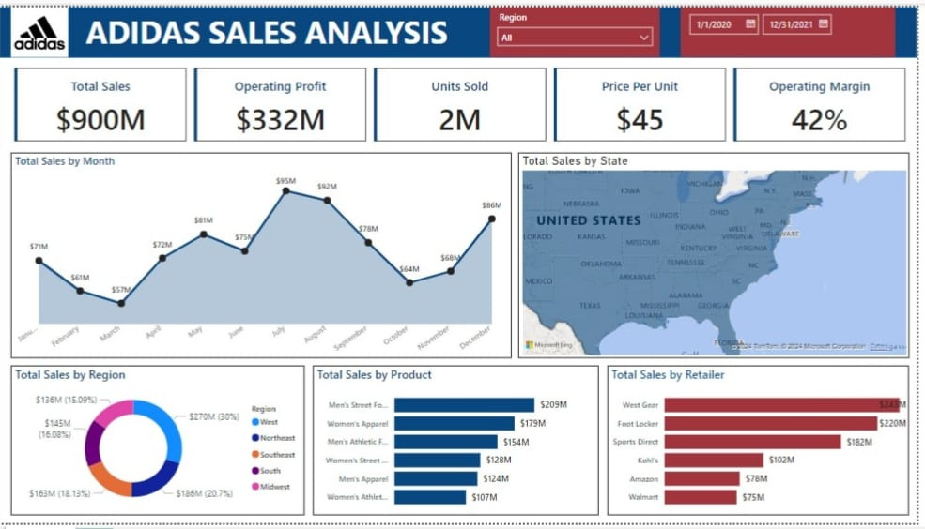
KEY FINDINGS
1.Total Sales and Profitability:
Total sales amounted to $900M. Operating profit stood at $332M, representing an operating margin of 42%, which indicates solid profitability. 2M units were sold at an average price per unit of $45.
2.Sales Trends Over Time:
Sales fluctuated throughout the year, peaking at $95M in August, followed by $92M in September. A significant dip occurred in February at $61M, while December saw a recovery with $86M in sales.

Slide 5

3.Sales by Region and State:
Northeast leads in total sales by region, contributing $270M (30% of total sales). The South region also performed well with $186M in sales. The map visualization shows sales concentrations across various U.S. states, though no specific state-level breakdown is provided in the current screenshot.
4.Sales by Product:
Men’s Street Footwear is the top-selling product category, generating $209M in sales. Women’s Apparel and Men’s Athletic Footwear also contribute significantly with sales of $179M and $154M, respectively.
5.Sales by Retailer:
West Gear emerges as the leading retailer, accounting for $245M in sales. Other top retailers include Foot Locker ($220M) and Sports Direct ($182M).

Slide 6

CONCLUSION
This Adidas sales analysis dashboard offers a clear and insightful view of sales performance across multiple dimensions. The dashboard highlights strong overall sales with a healthy operating margin. The sales peak in mid-year (August and September) and show signs of recovery in December, suggesting possible seasonal factors or successful marketing campaigns.
In terms of product categories, men's street footwear dominates sales, while West Gear is the leading retail partner. This dashboard would enable decision-makers to identify key areas for growth and improvement, particularly in underperforming months and product categories.

Slide 7

THANK YOU
https://www.linkedin.com/in/hrithik-muthanna-35a2a3273

